Slide 1
GAPP Partnership Webinar
May 13th and 14th, 2024

Slide 2
Today’s Agenda
1. | Who is GAPP?
2. | Amazing Wild Alaska Pollock
3. | Partnership Program Overview
4. | Focus this Round
5. | How to Apply
6. | Benefits of Partnering with GAPP

Slide 3
Who is GAPP?
Genuine Alaska Pollock Producers

Slide 4

We’re advocates for one of the world’s most sustainable and nutritious seafood products…
Wild Alaska Pollock!

Slide 5
GAPP Members
Processor Members
Catcher Boats and CDQs
  Alyeska Seafoods
  American Seafoods
  Arctic Fjord/Arctic Storm
  Glacier Fish Company
  Golden Alaska Seafoods
  Northern Hawk
  Ocean Beauty/OBI
  Phoenix Partnership Limited Partnership
  Trident Seafoods
  Unisea
  Westward Seafoods
  Westward Seafoods – Northern Victor Division
  Akutan Catcher Vessels Association
  Aleutian Pribilof Island Community Devt. Assoc.
  Bristol Bay Economic Development. Corp.
  Central Bering Sea Fishermen’s Association
  Coastal Villages Region Fund
  High Seas Fleet Cooperative
  Northern Victor Fleet Cooperative
  Norton Sound Economic Development Corp.
  Unalaska Fleet Cooperative
  Unisea Fleet Cooperative
  Westward Fleet Cooperative
  Westward Fleet Cooperative – N. Victor

Slide 6
GAPP Overview
Overview
The Association of Genuine Alaska Pollock Producers (GAPP) is a nonprofit that advocates for one of the world’s most sustainable and nutritious seafood products, U.S.-caught Wild Alaska Pollock.
Mission
To build demand and awareness for the fish through driving product innovation, conducting research, and creating awareness about product quality and the responsibly managed fishery the product comes from.
Learn more at www.alaskapollock.org.

Slide 7

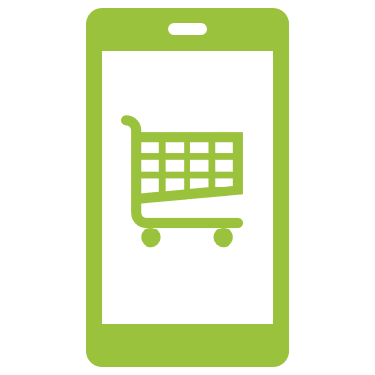

What do we do?
Marketing & Communications
New Product Partnerships
Data & Insights

Slide 8
So, what’s so amazing about
Wild Alaska Pollock?

Slide 9
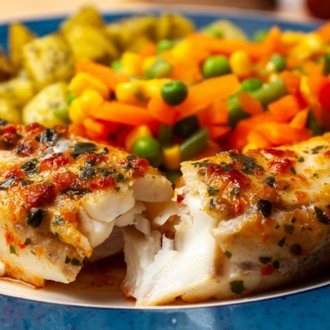
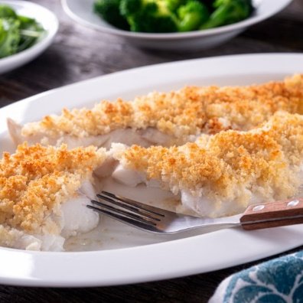
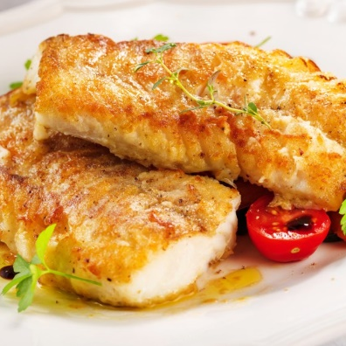
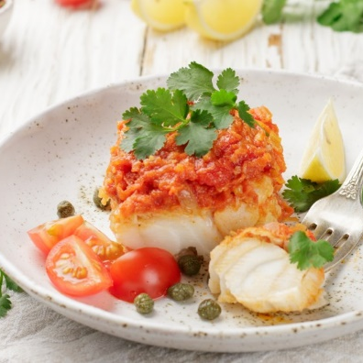
The World’s Best Whitefish
Taste
Nutrition
Wild-Caught/Alaska Origin
Sustainability
Wild Alaska Pollock is a low-fat, protein-rich, great tasting and versatile white fish
.
A true superfish: low-fat, protein-rich, heart-healthy, high in vitamin B-12 and loaded with omega-3 fatty acids.
Raised and caught in its natural habitat. Caught and frozen while still at sea to preserve freshness, taste, and nutrition.
Wild Alaska Pollock
is one of the most abundant certified-sustainable fish in the world, making it one of the best protein choices for the planet.

Slide 10
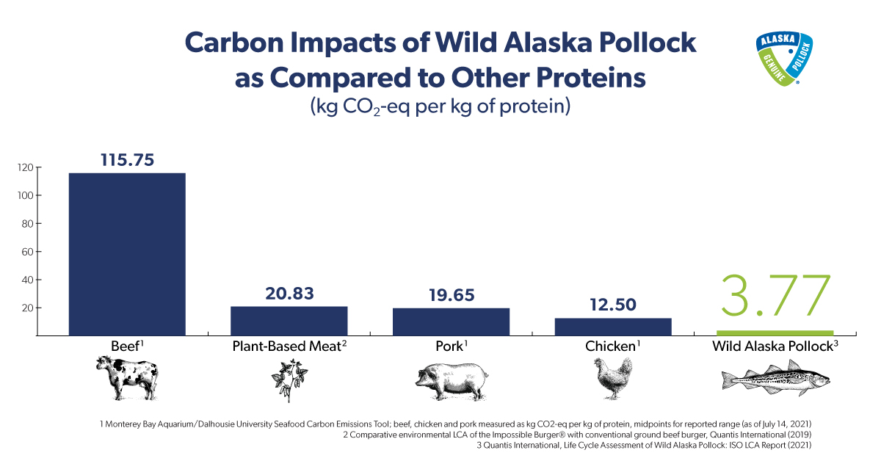
Among the Most Climate Friendly
Proteins on the Planet (Fillet)

Slide 11
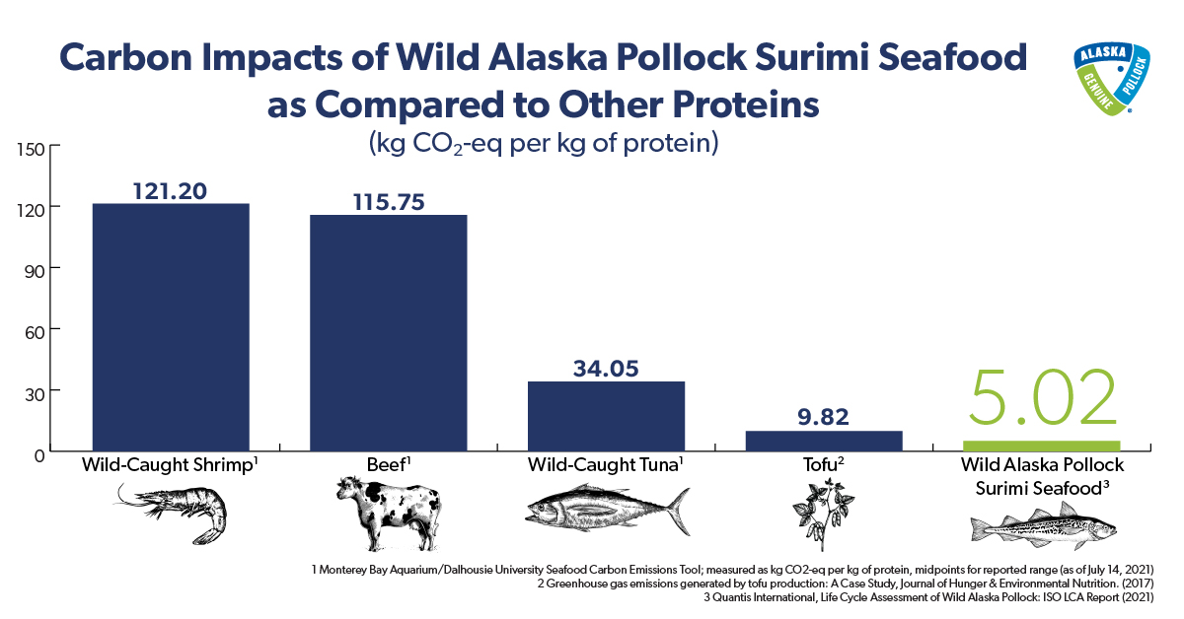
Among the Most Climate Friendly
Proteins on the Planet (Surimi)

Slide 12
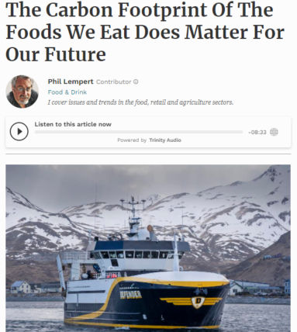
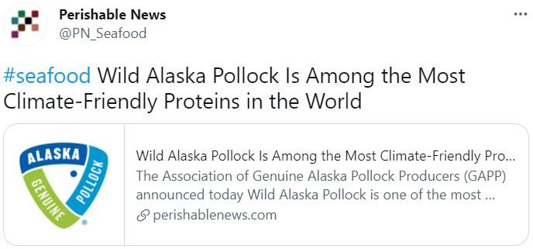

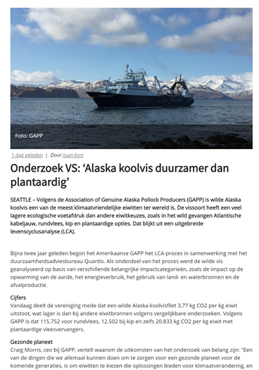
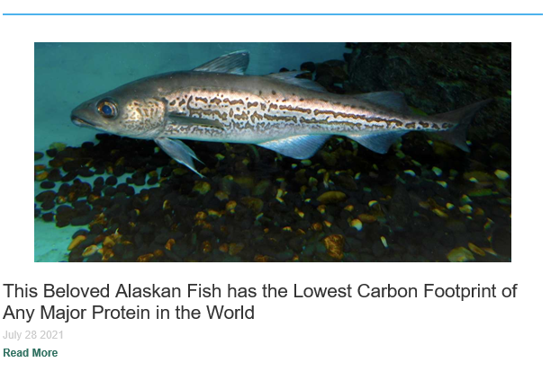

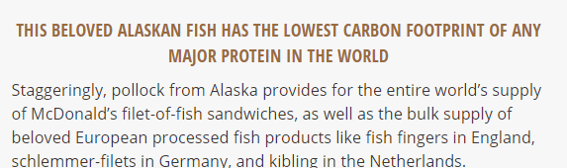
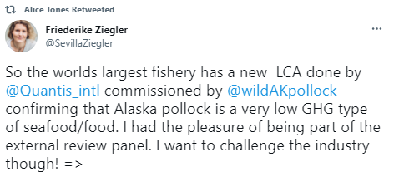
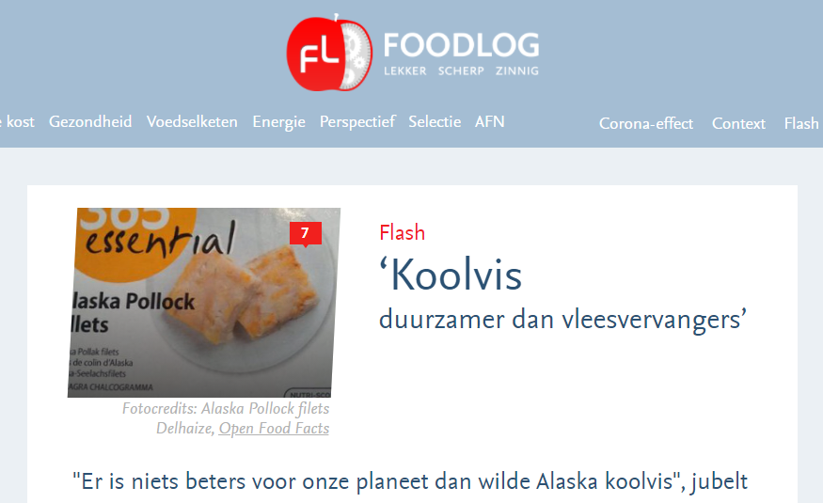

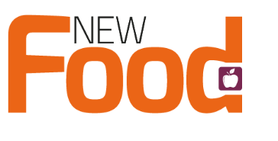
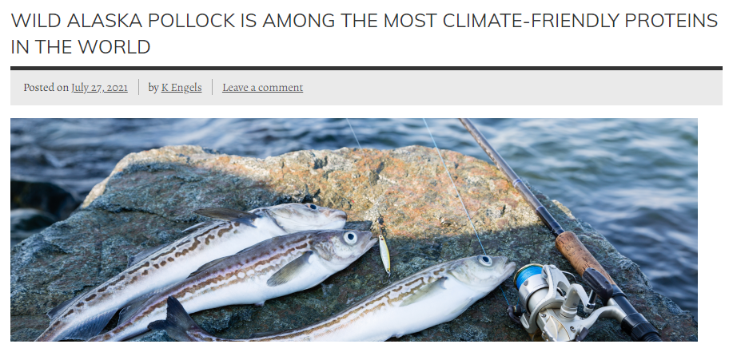
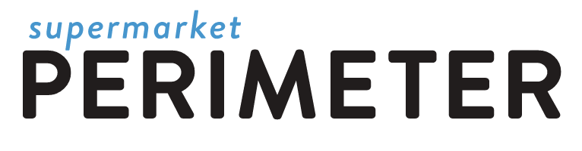
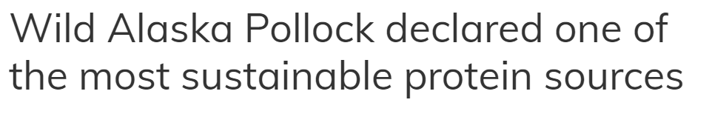
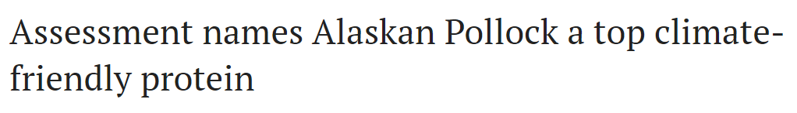
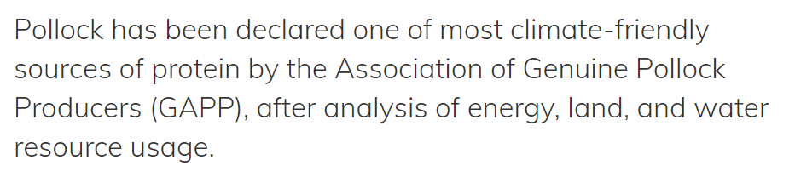
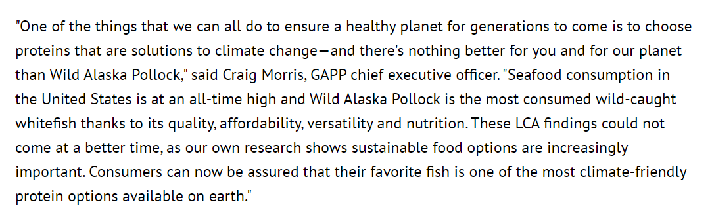
The Secret is Out!
Wild Alaska Pollock in the News

Slide 13
Partnership
Program Overview

Slide 14
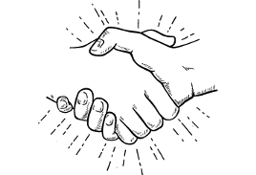
Partnership Program
Designed to increase awareness of Wild Alaska Pollock & elevate the species
Goal is to introduce the species to new consumers through new forms and channels
This is an opportunity to get matching dollars (up to 1-1)
Looking for innovative and break through ideas – all product forms included
Gain learning & share that learning within the Wild Alaska Pollock Community

Slide 15
Focus this Round

Slide 16
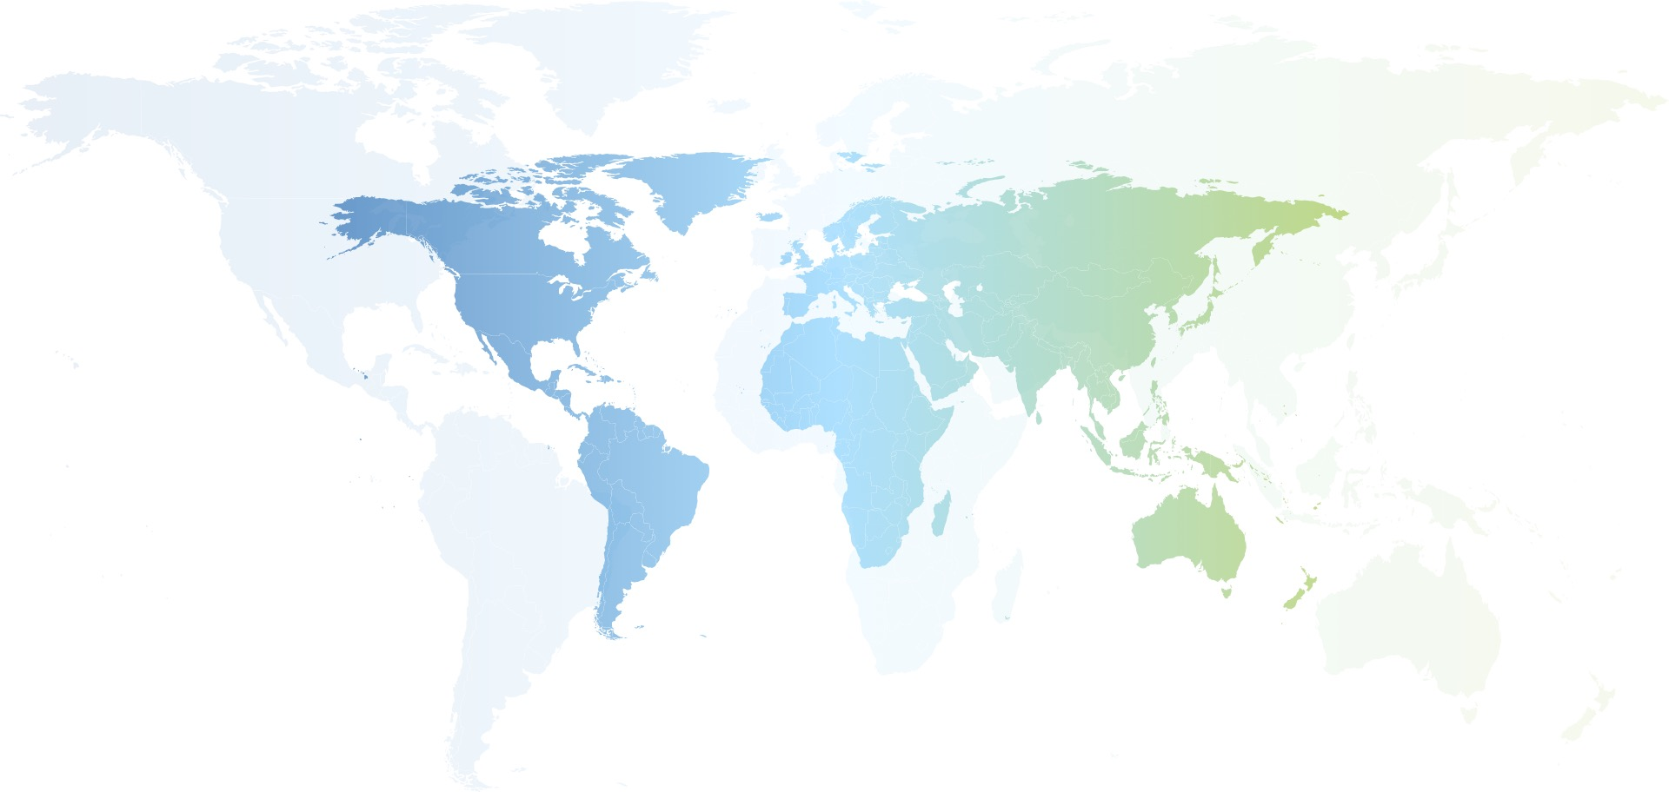
Global Perspective
We welcome proposals from every country
  2040 Markets: Spain, Malaysia, Poland, France, Germany, Japan, South Korea, United Arab Emirates

Slide 17
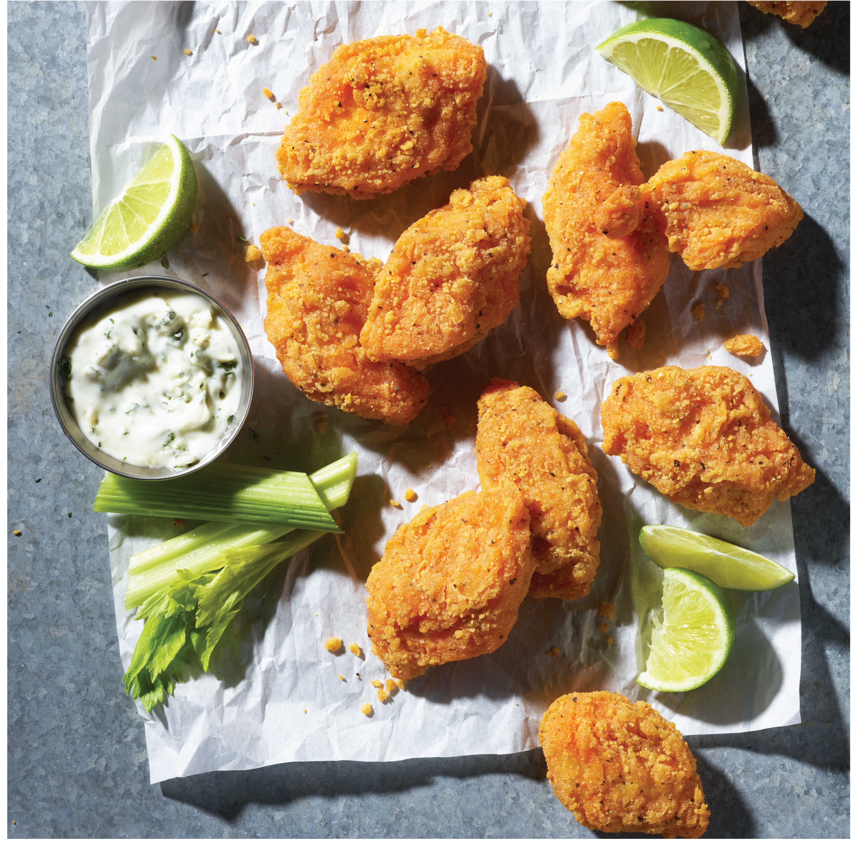
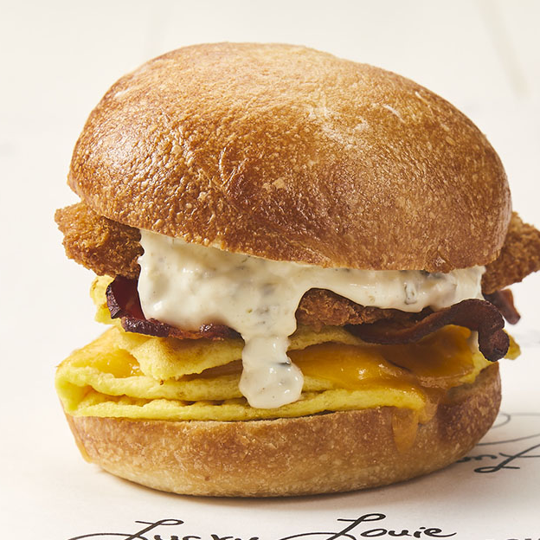
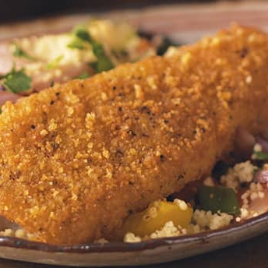
We Love Our Base Business and Will
Continue to Support It
“Wild Alaska Pollock” on the menu, POS, packaging and all marketing communication
Spend resources to increase awareness and demand through campaigns, social and influencer programs
Continue to drive great taste and imagery

Slide 18
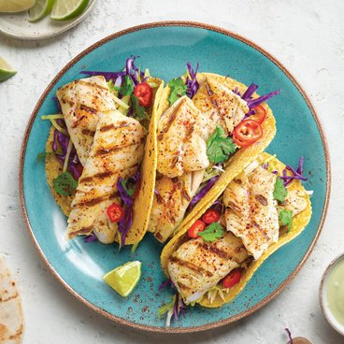
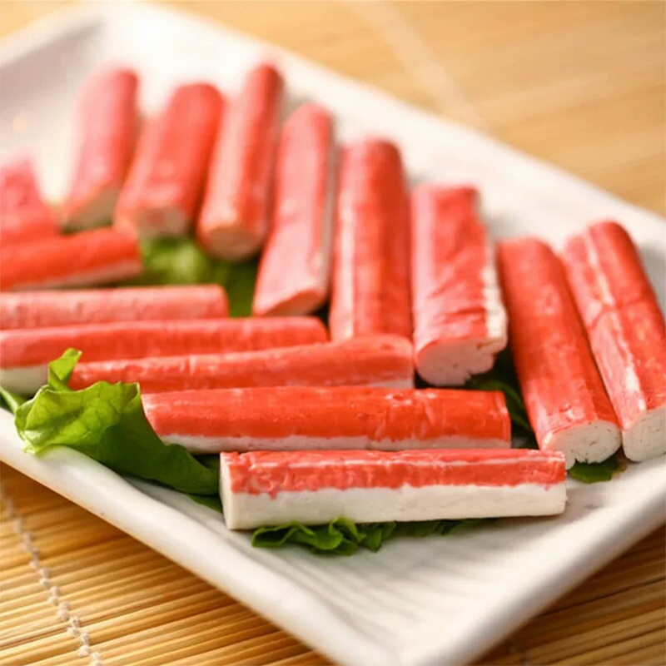
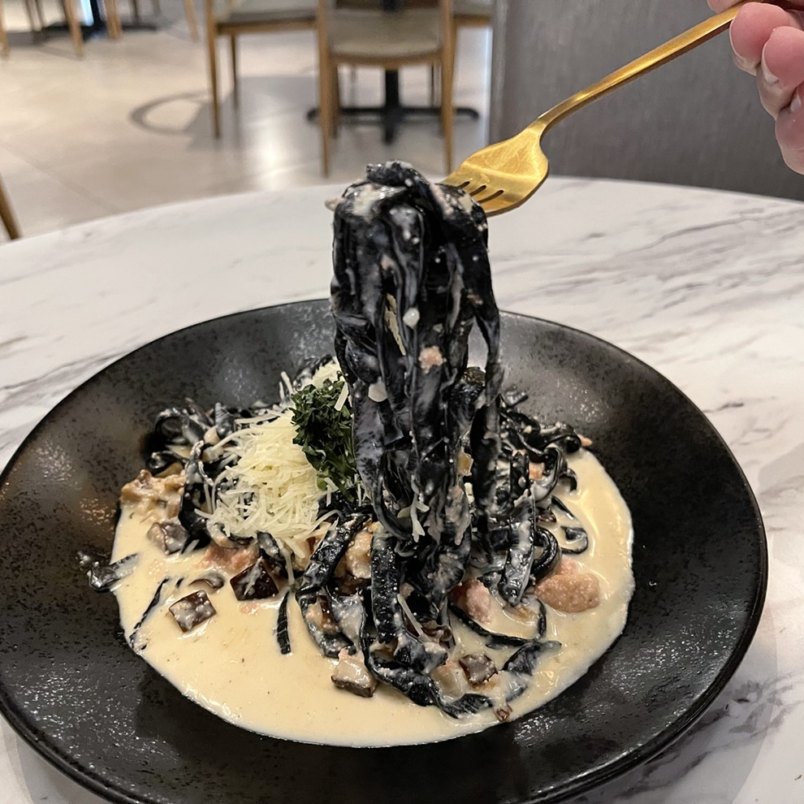
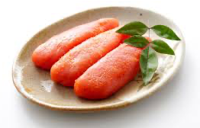
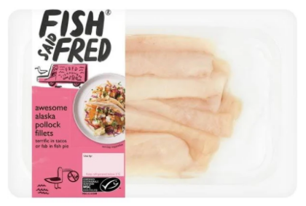
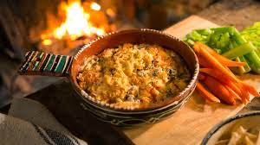
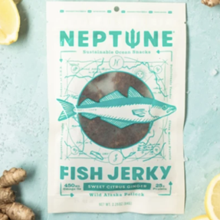
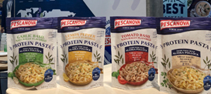
We Are Also Looking to Expand Product Formats
IQF/Fillet
Surimi
Roe
Innovation

Slide 19
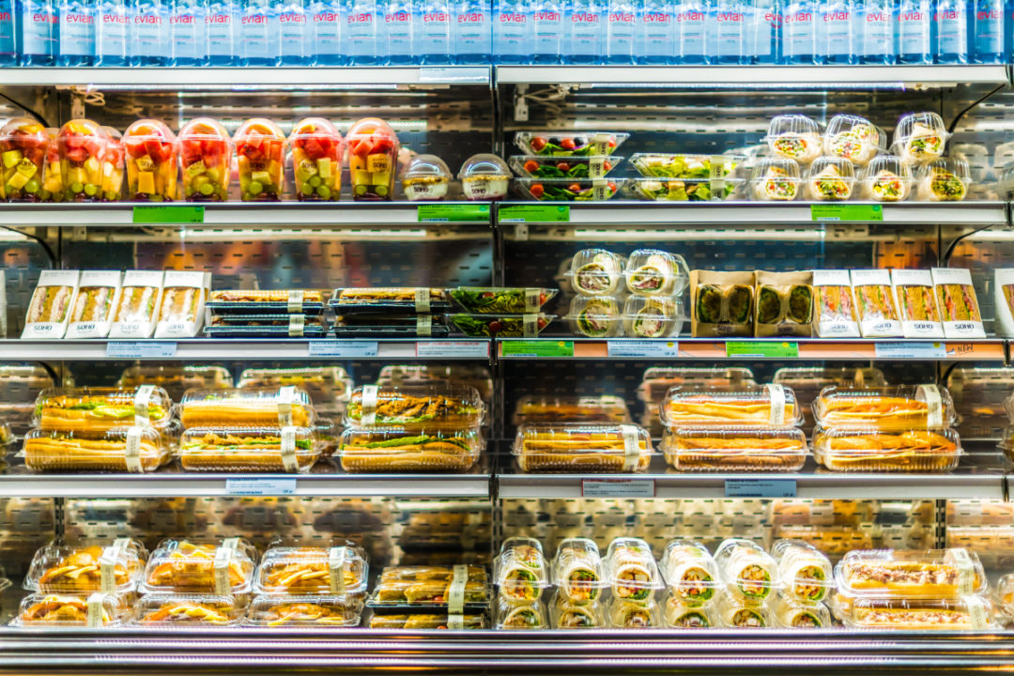
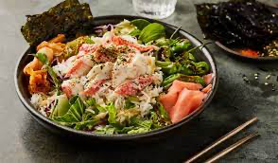

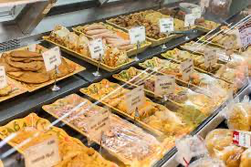
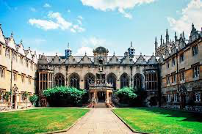
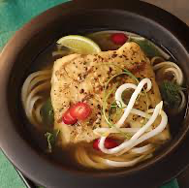
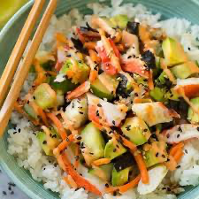
Growth Channels - Areas that Elevate
& Increase Awareness
Chilled / Deli
Casual Restaurants
Corporate Restaurants / Institutions

Slide 20
What are we looking for?
Communication:
  Build awareness of Wild Alaska Pollock
  Help us tell the story of Wild Alaska Pollock & its many benefits
  Support through social, influencers, etc.
New Products
  Support new product launches
  Continue to drive awareness and demand for some of the lesser-known forms
New Channels
  New aisles in grocery
  Out of home/restaurants

Slide 21
How Do You Apply?

Slide 22
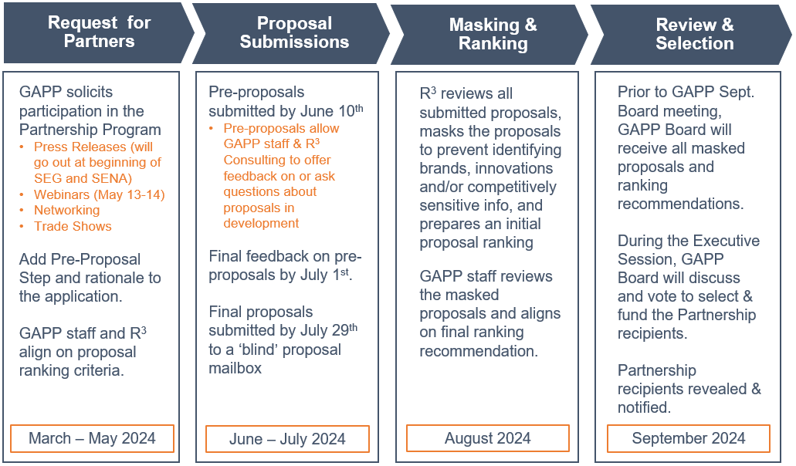
The New Partnership process

Slide 23
We’ve Made this Easy… for You!
Key Information
Key Information/Overview on GAPP Website
https://www.alaskapollock.org/about-us/programs
Full Program Details/RFP
Program Submission Form (Attachment A)
Sample Report Metrics (Attachment B)

Slide 24
Submission Form
1.
The
Basics
2.
Source
& Region
3.
Description
& Objectives
4.
Metrics &
Measurement
Project Name
Key Dates
Spend in U.S. Dollars
Product
Supplier
Market/region
Overview of proposal
SMART Goals
Key metrics
Demonstrate ROI for spend & industry

Slide 25
Benefits of
Partnering with GAPP

Slide 26

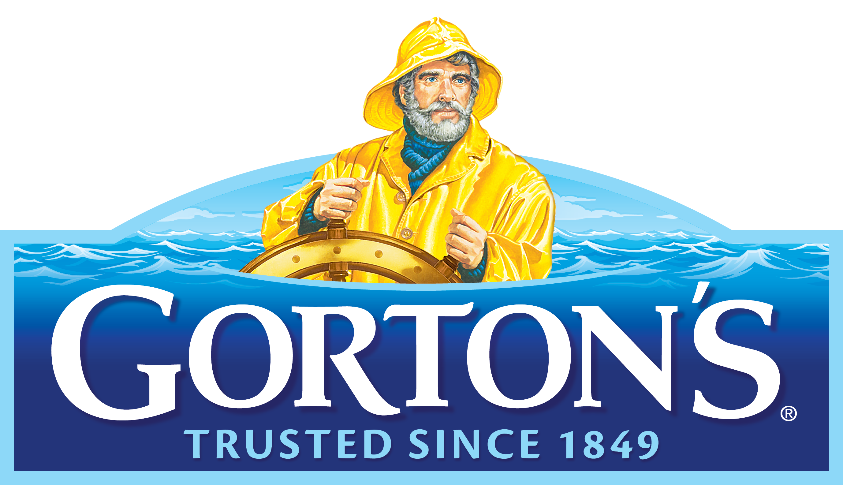

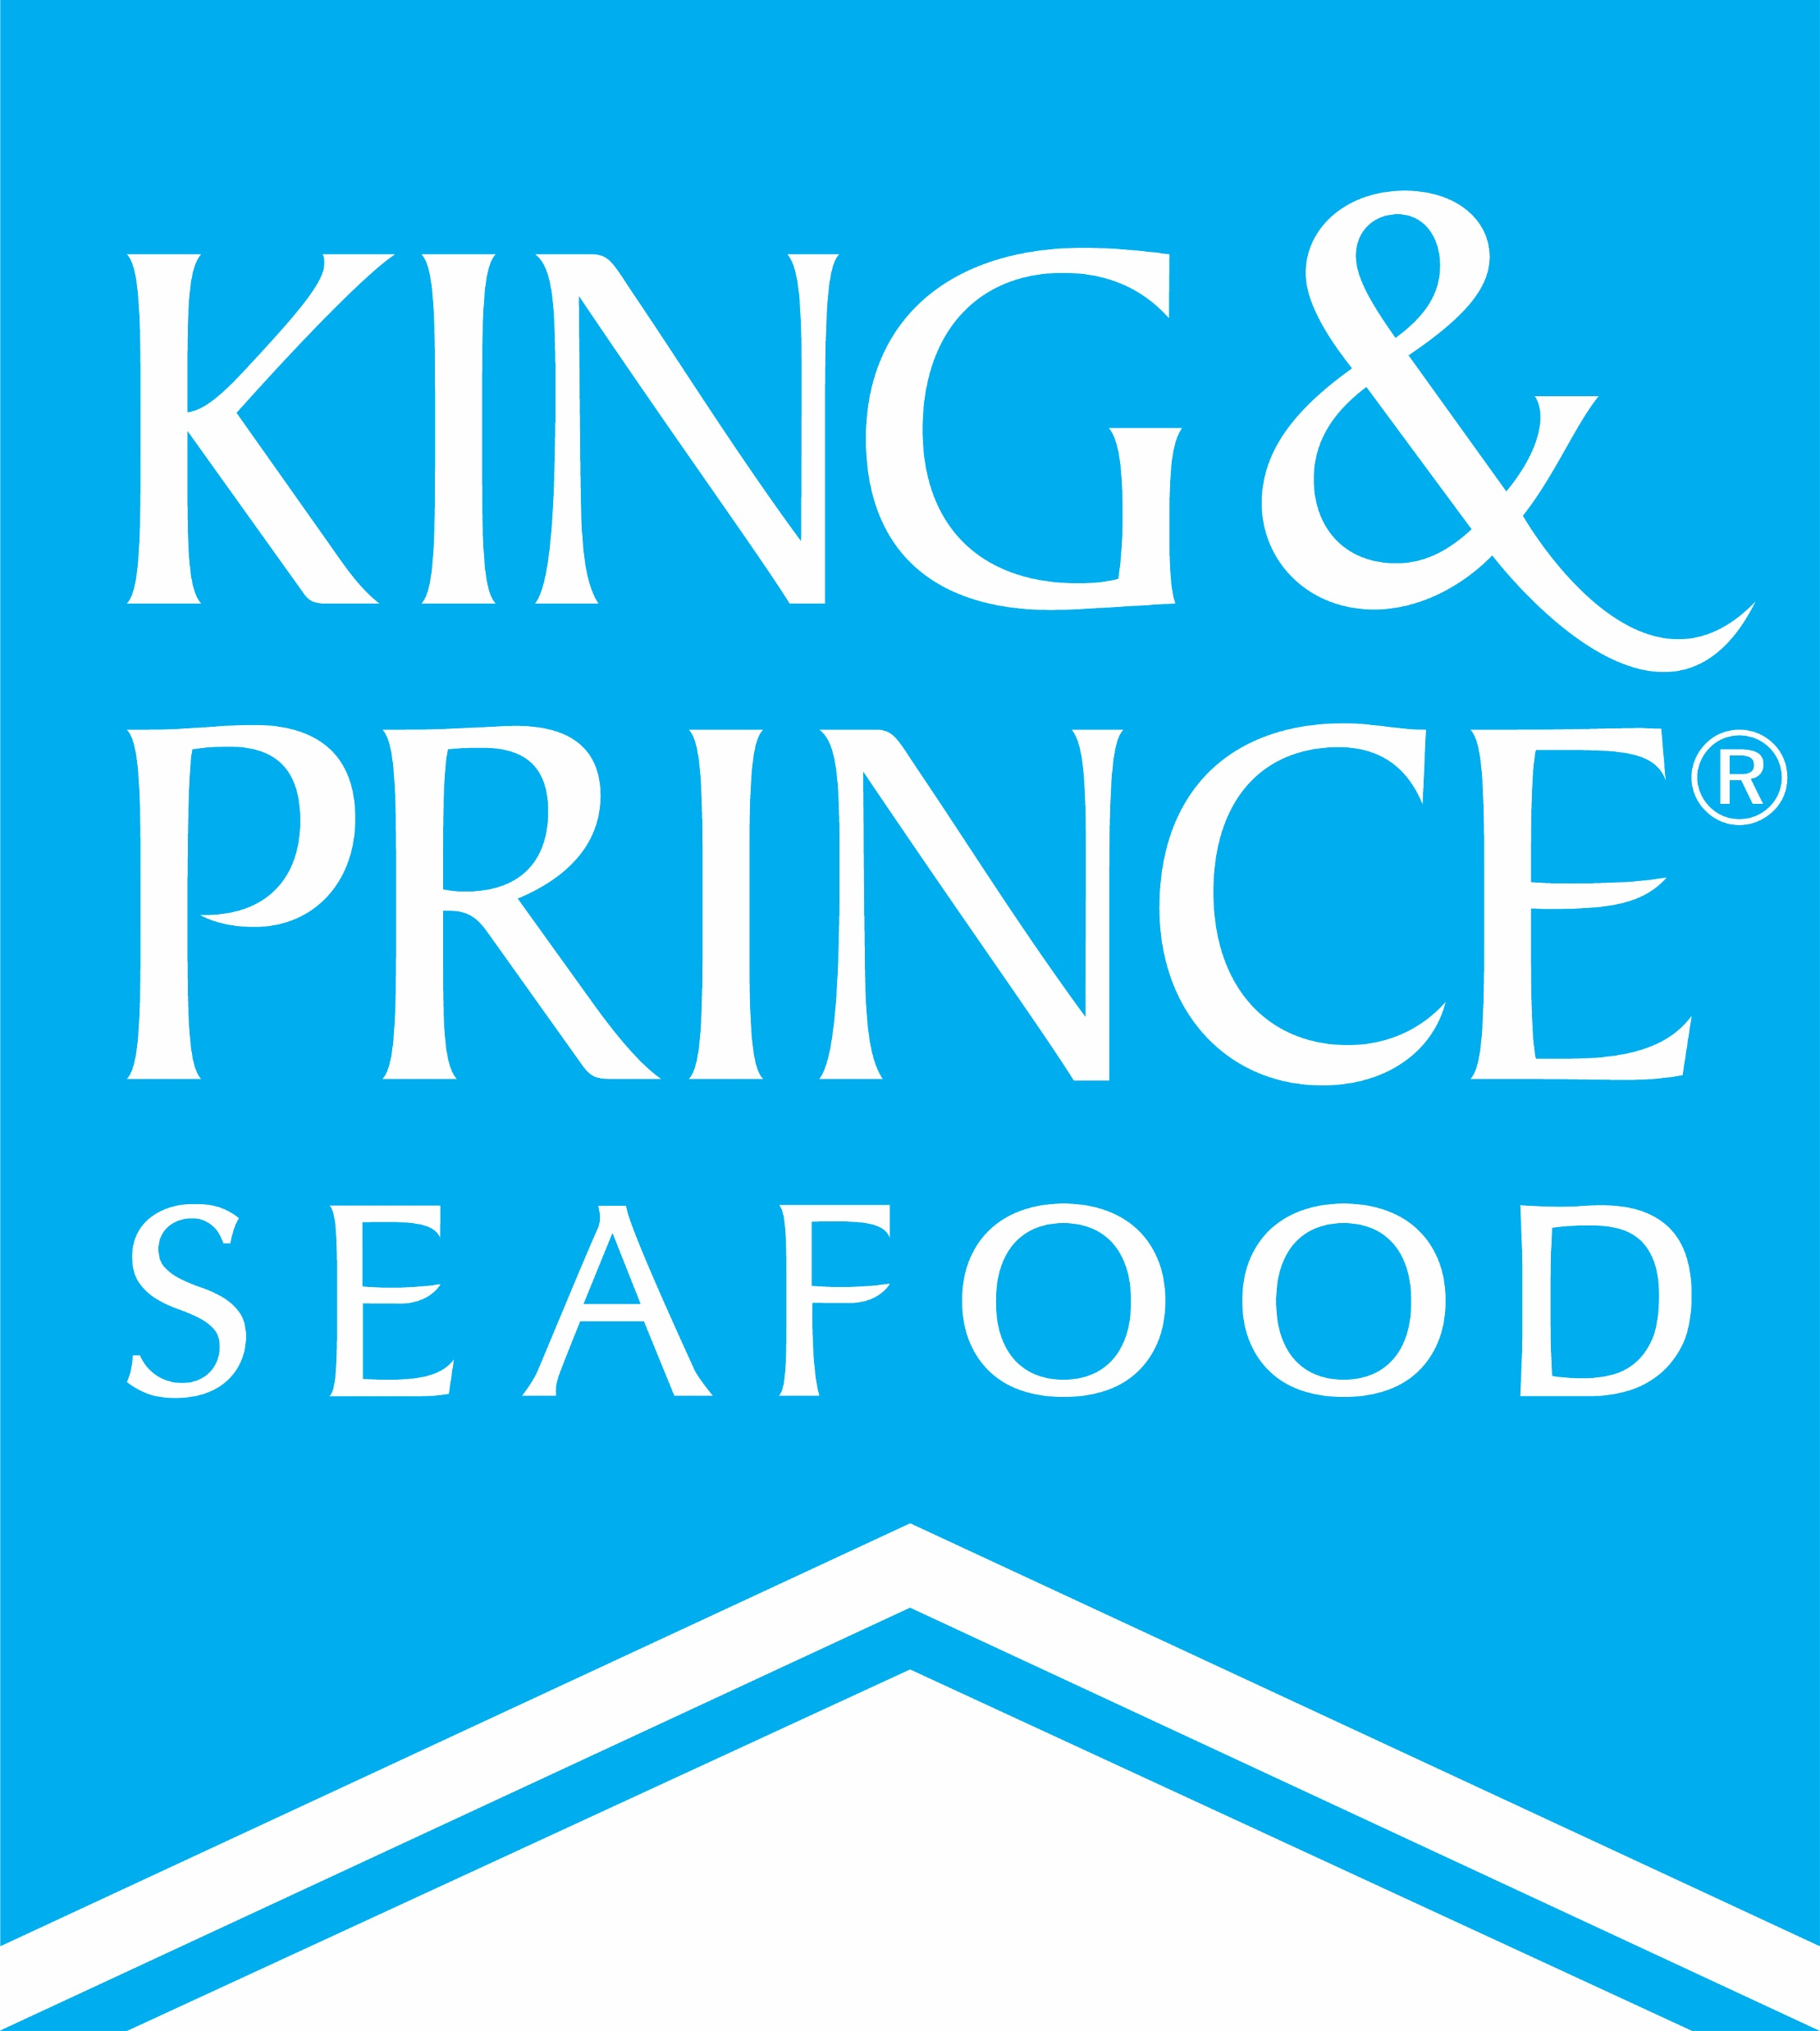

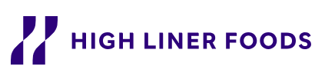
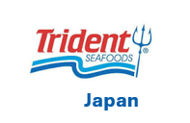
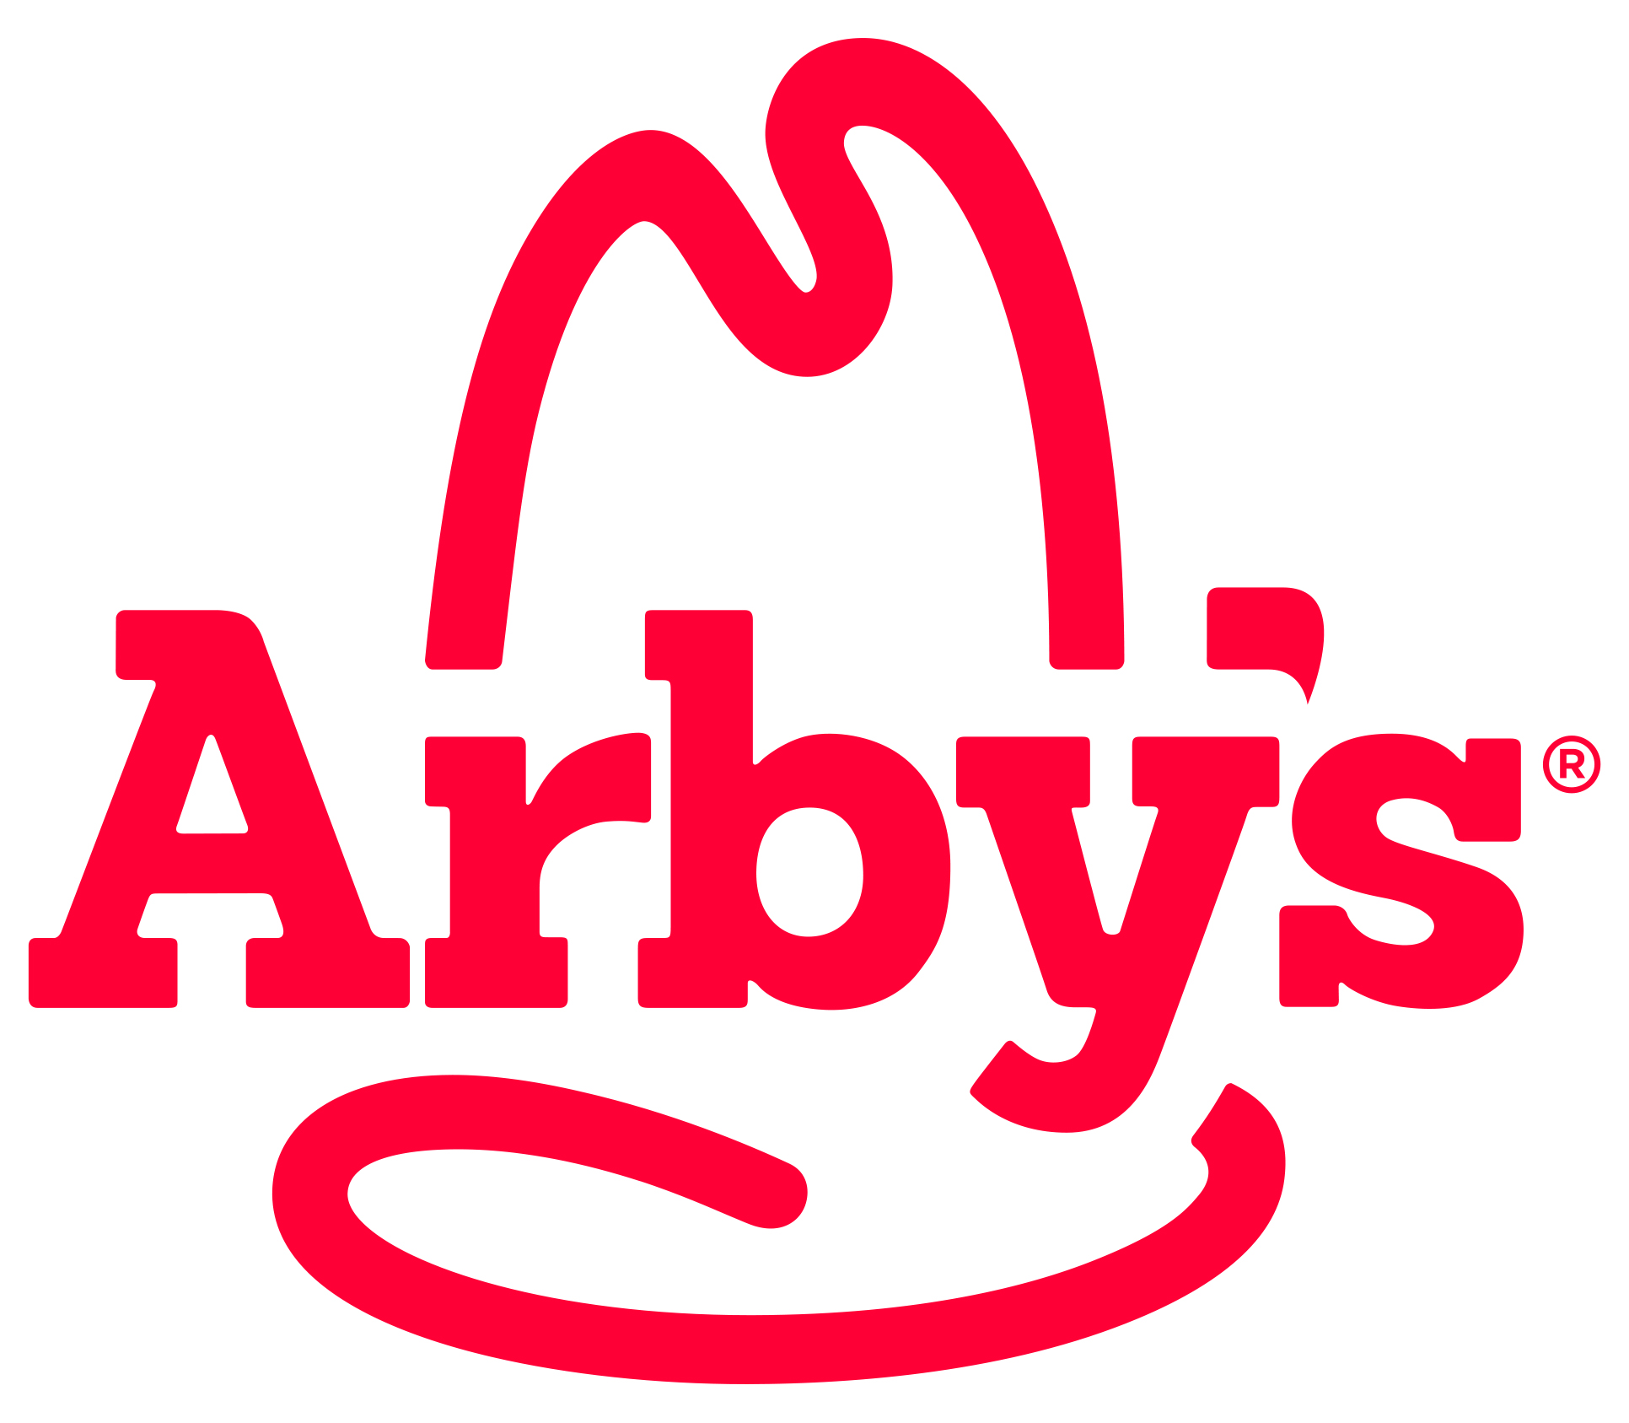


Our 2023/24 Partners!

Slide 27
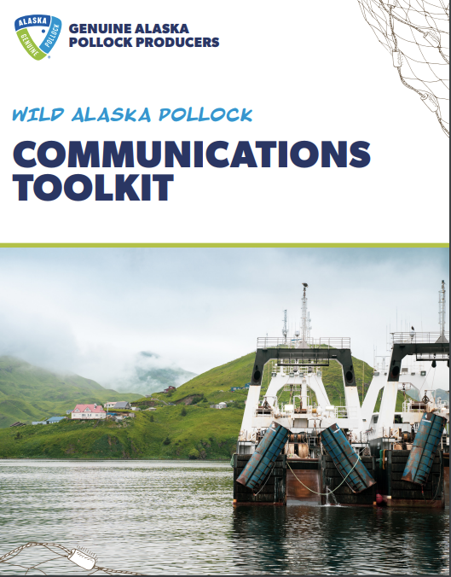
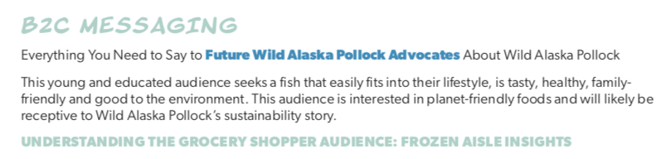
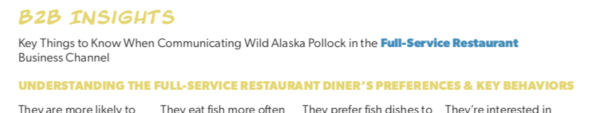
We Want You to Leverage Our Expertise
New Communication/Toolkit!
Research
Social Partner
Awareness and Usage Studies
Global Nutrition Research
Annual Trackers
2040 Growth Markets
Provide guidance and expertise
Create and disseminate content
Partner on all communication

Slide 28
What Do We Want from Partners?
All Partners will be required to sign a Memorandum of Understanding (MOU)
Provide quarterly updates on programs
Alignment on key Wild Alaska Pollock messaging
Summary report that includes key learning and performance

Slide 29
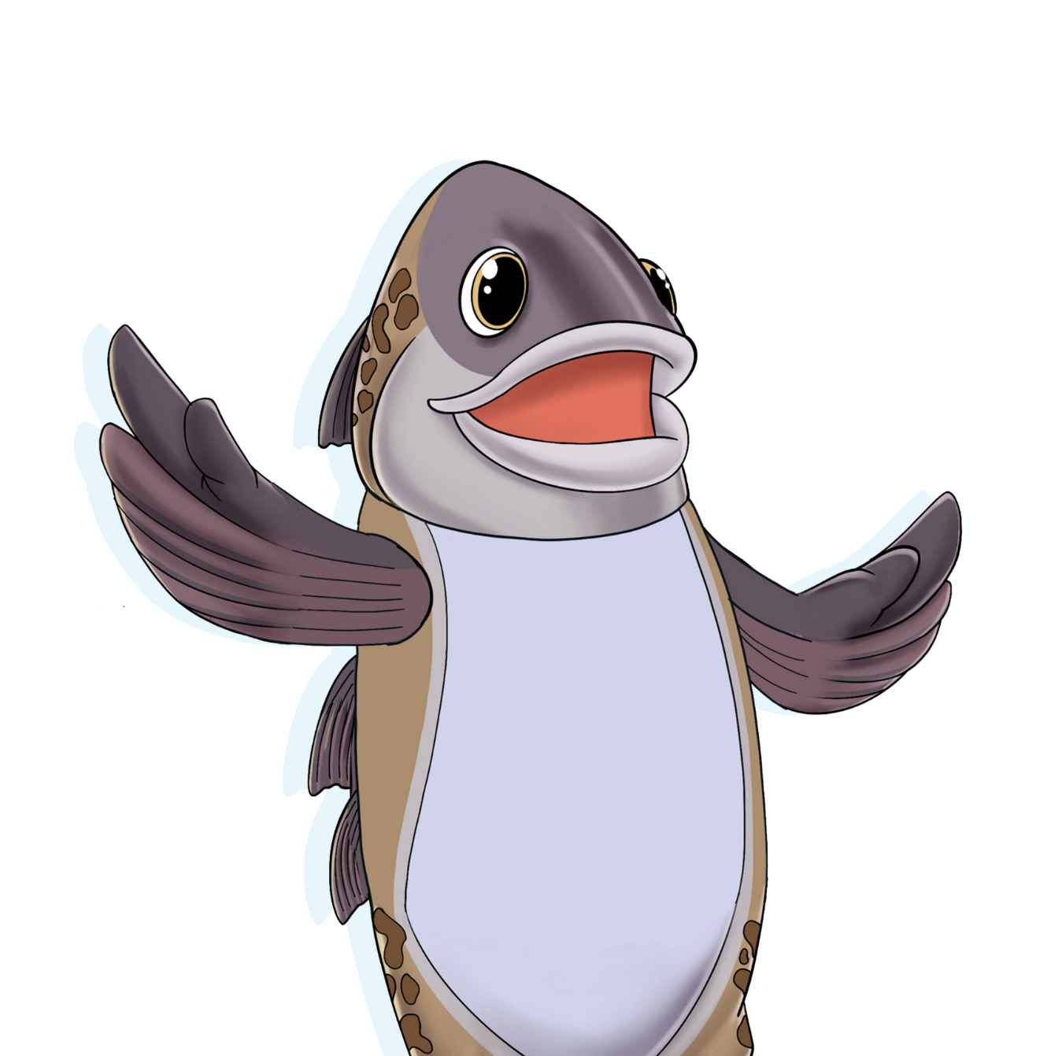
Excited about Wild Alaska Pollock?
We are too!
Questions?

Slide 30
Thank You!
For any additional questions or to submit a proposal, please reach out to Ron Rogness at Ron.Rogness@alaskapollock.org

